Slide 1

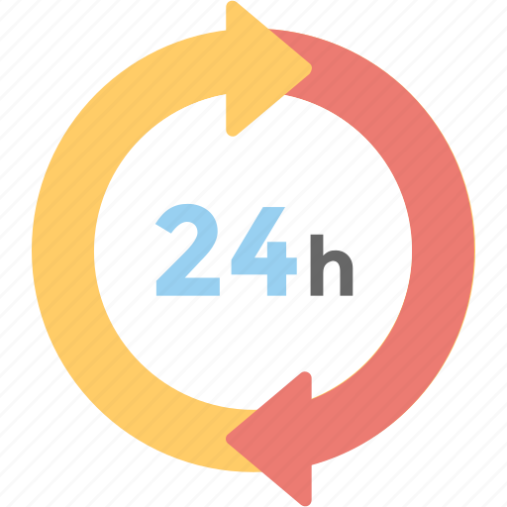
24-HOUR FORECAST
28-10-2022 @ 1200 UTC
Department of Meteorology and Climate Science,
KNUST.

Slide 2
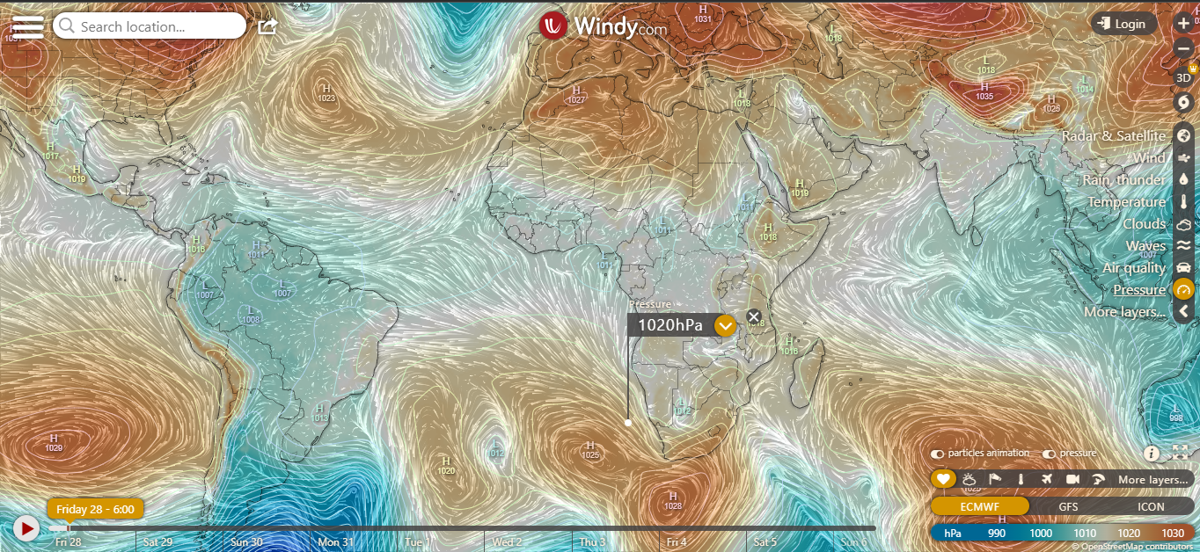
Presure System @ 0600 UTC
1023 hPa
1025hPa

Slide 3
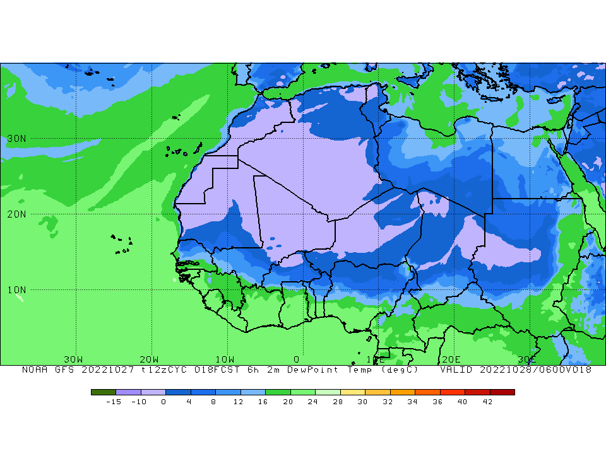

ITD POSITION @ 0600 UTC
ITD Position at 0600 UTC
$$11°N$$
℃

Slide 4
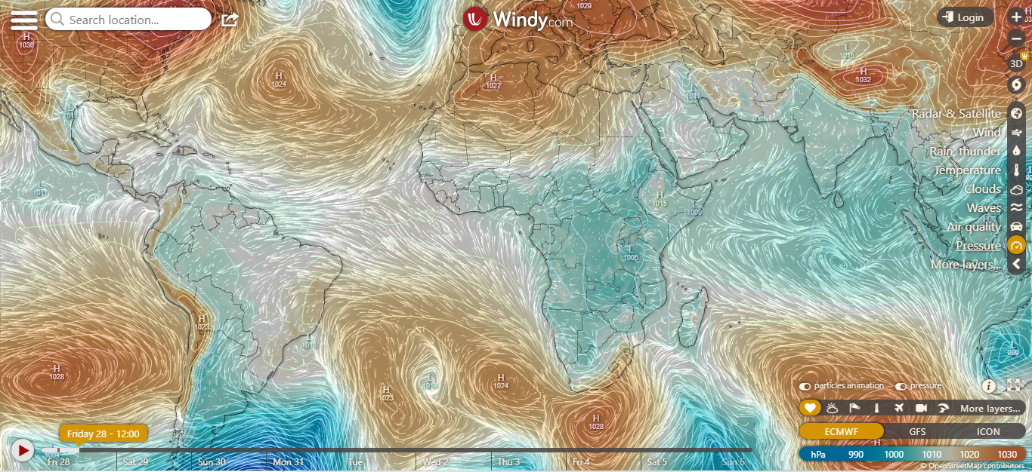
Presure System @ 1200 UTC
1024 hPa
1024 hPa

Slide 5
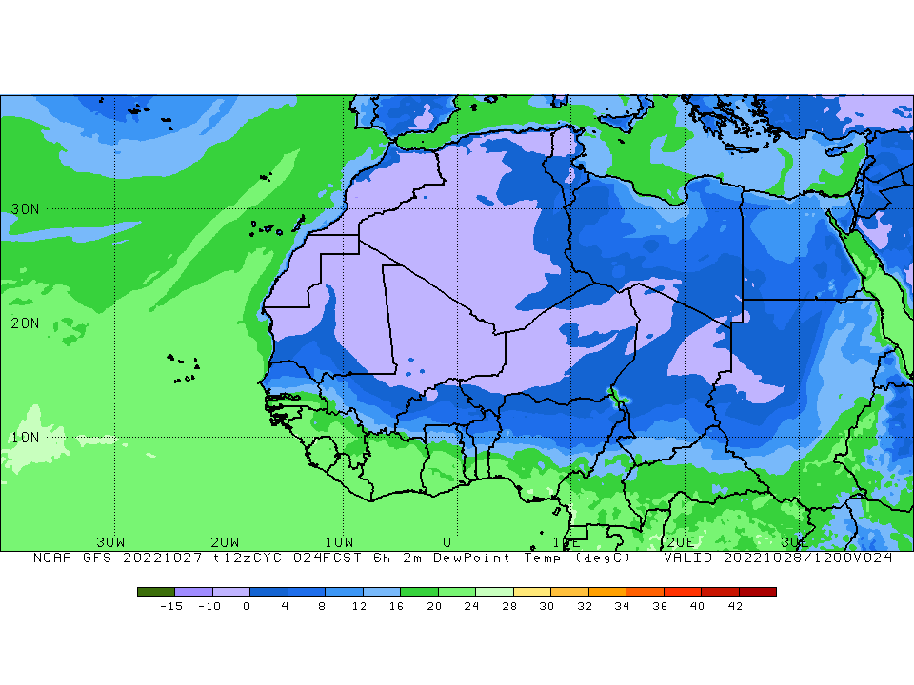

ITD POSITION @ 1200 UTC
ITD Position at 1200 UTC
$$10°N$$

Slide 6
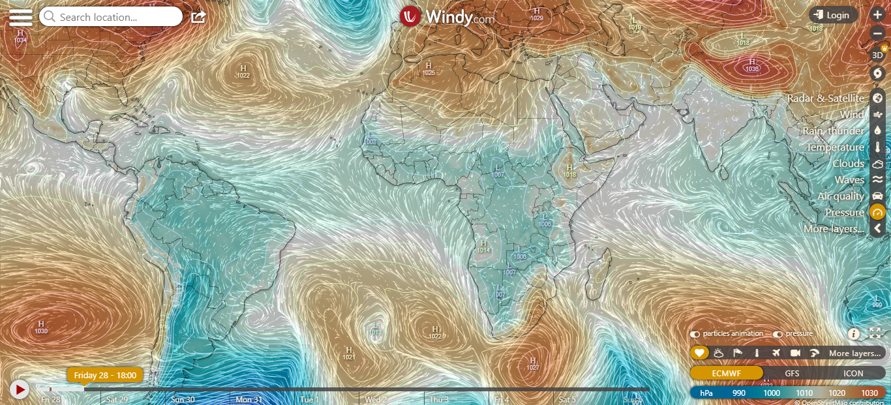
Presure System @ 1800 UTC
1022 hPa
1022 hPa

Slide 7
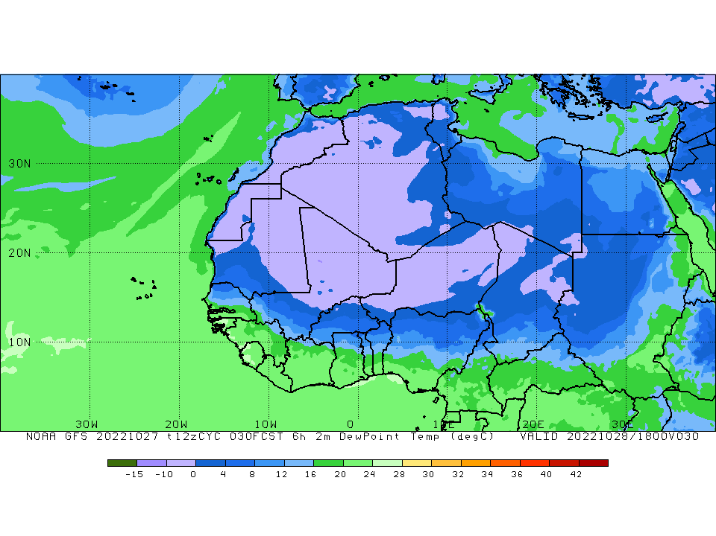

ITD @ 1800 UTC
ITD Position at 1800 UTC
$$10°N$$

Slide 8
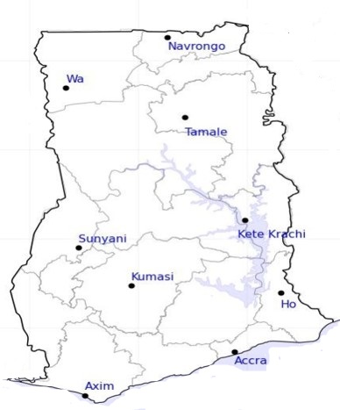
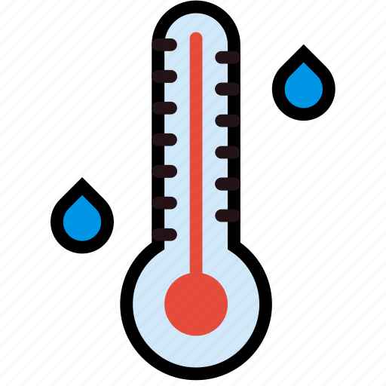





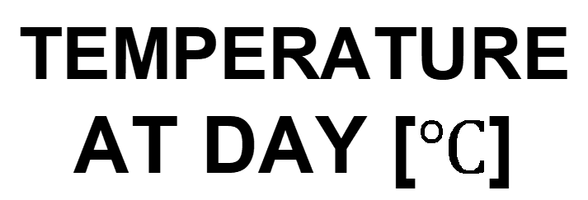
$$34$$
24-HOUR FORECAST
28-10-2022 @ 1200 UTC
$$34$$
TEMPERATURE AT DAY [$℃$]
34
34
32
$$31$$
$$32$$
$$31$$
$$28$$
$$28$$

Slide 9





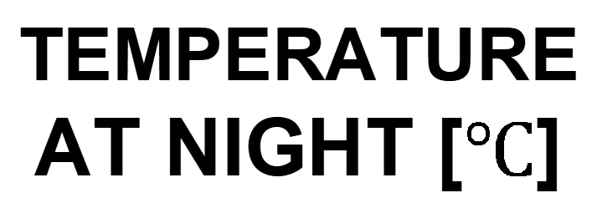
$$24$$
24-HOUR FORECAST
28-10-2022 @ 1200 UTC
$$23$$
TEMPERATURE AT NIGHT [$℃$]
$$25$$
$$24$$
$$27$$
23
$$24$$
$$24$$
$$25$$
$$26$$

Slide 10

24-HOUR FORECAST
28-10-2022 @ 1200 UTC
31
41
RH AT DAY
[%]
47
44
63
66
62
64
79
80

Slide 11
67
24-HOUR FORECAST
28-10-2022 @ 1200 UTC
74
RH AT NIGHT
[%]
70
76
85
92
97
95
91
89

Slide 12
0
24-HOUR FORECAST
28-10-2022 @ 1200 UTC
0
CAPE AT 1200
391
20
1223
800
J/kg
22
711
987
715

Slide 13
0
24-HOUR FORECAST
28-10-2022 @ 1800 UTC
65
CAPE AT 1800
20
0
1888
815
J/kg
1192
980
852
413

Slide 14



GENERAL OUTLOOK
24-HOUR FORECAST
28-10-2022 @ 1200 UTC
Rain
Wind
Dust
PROBABILITY OF RAINS
10-30%
Low risk
Be aware
Be Prepared
Take Action

Slide 15
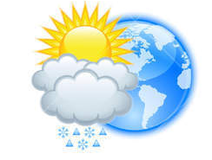




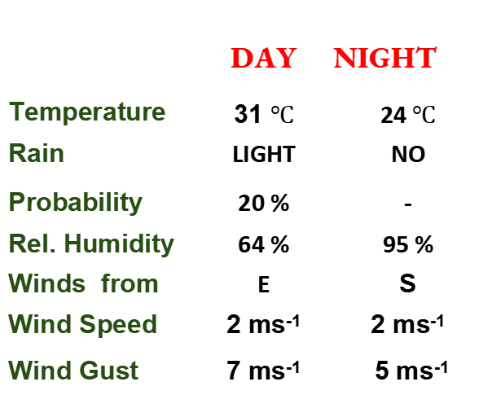
Meteorology and Climate Science
Department of Meteorology and Climate Science , KNUST
24-HOUR FORECAST
28-10-2022 @ 1200 UTC
Rain
Wind
Dust
Forecast Summary (KUMASI)
 | DAY | NIGHT
Temperature | 31 $℃$ | 24$℃$
Rain | LIGHT | NO
Probability | 20 % | -
Rel. Humidity | 64 % | 95 %
Winds from | E | S
Wind Speed | 2 ms⁻¹ | 2 ms⁻¹
Wind Gust | 7 ms⁻¹ | 5 ms⁻¹
Low risk
Be aware
Be Prepared
Take Action
SUNSET: 05:43 PM SUNRISE: 05:54 AM

Slide 16


